Slide 1
Machine learning Project
Johnny Fares
56070

Slide 2
This project is a website built with Django framework using python language to predict handwritten letter and digit using tensorflow library

Slide 3
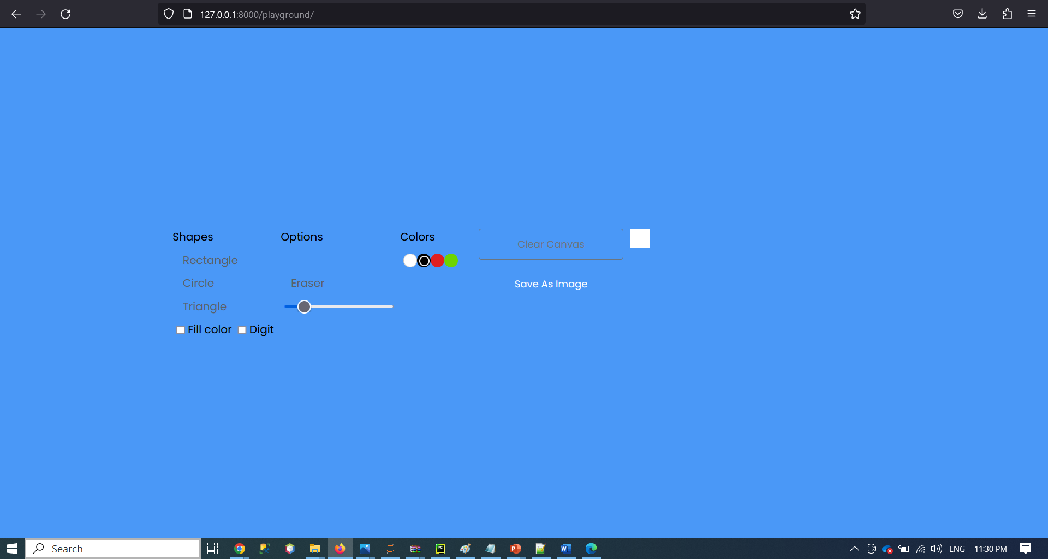
The user choose if he wants to draw a digit or a letter by checking the Digit checkbox and he starts drawing his shape in the white box then he press save as image so that the model predicts the value.

Slide 4
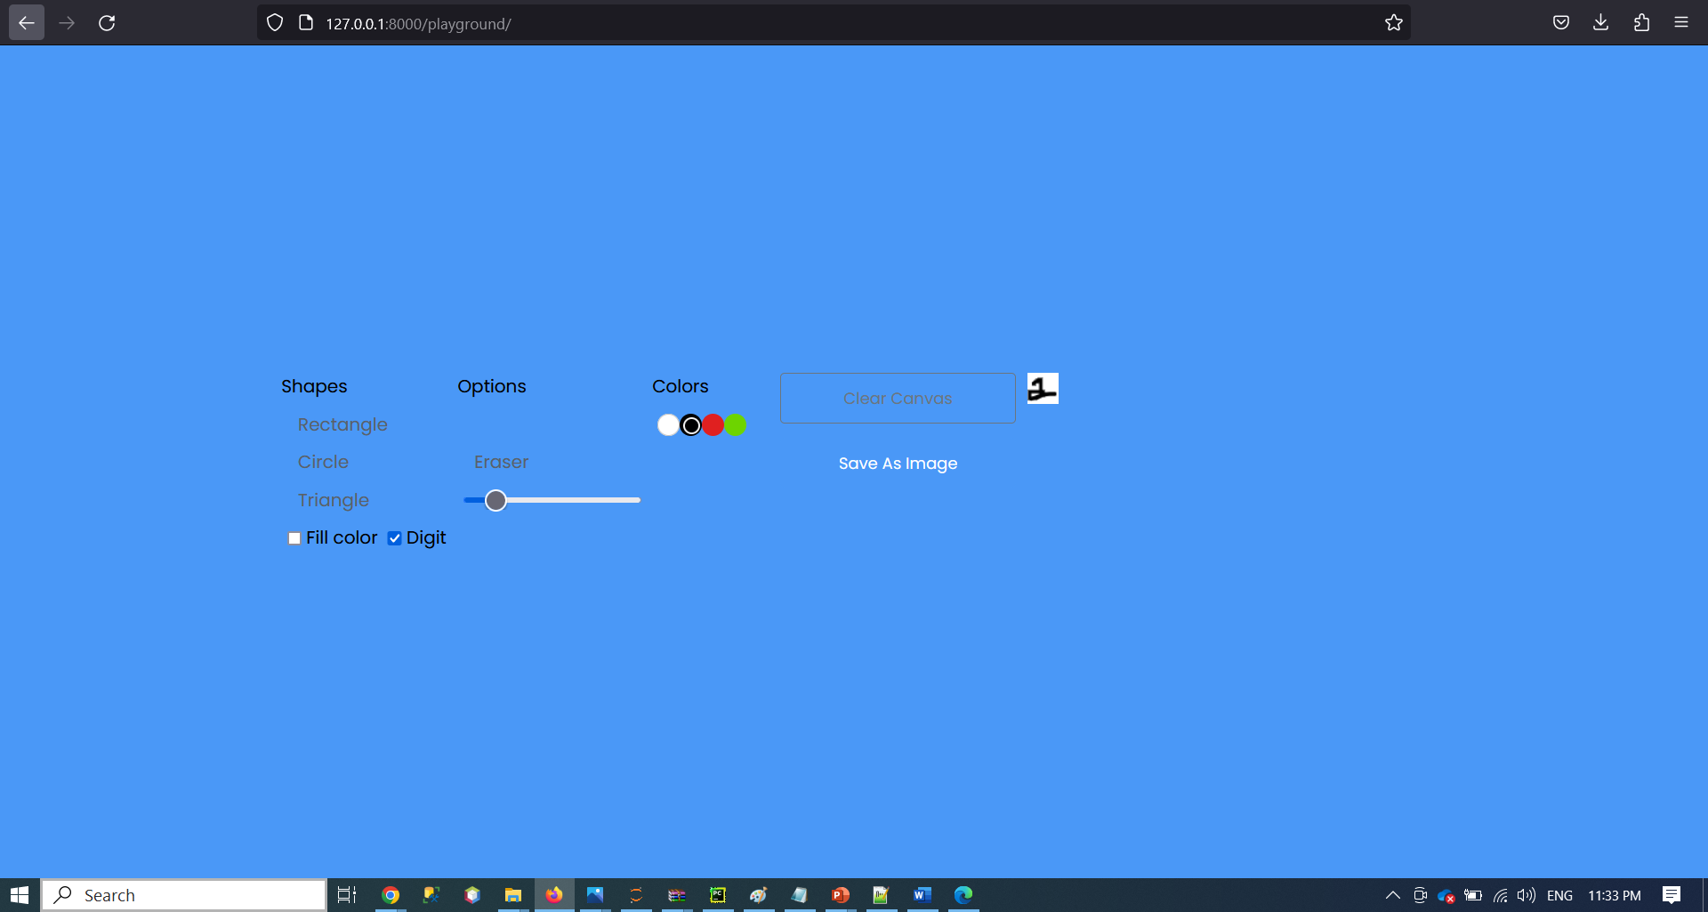
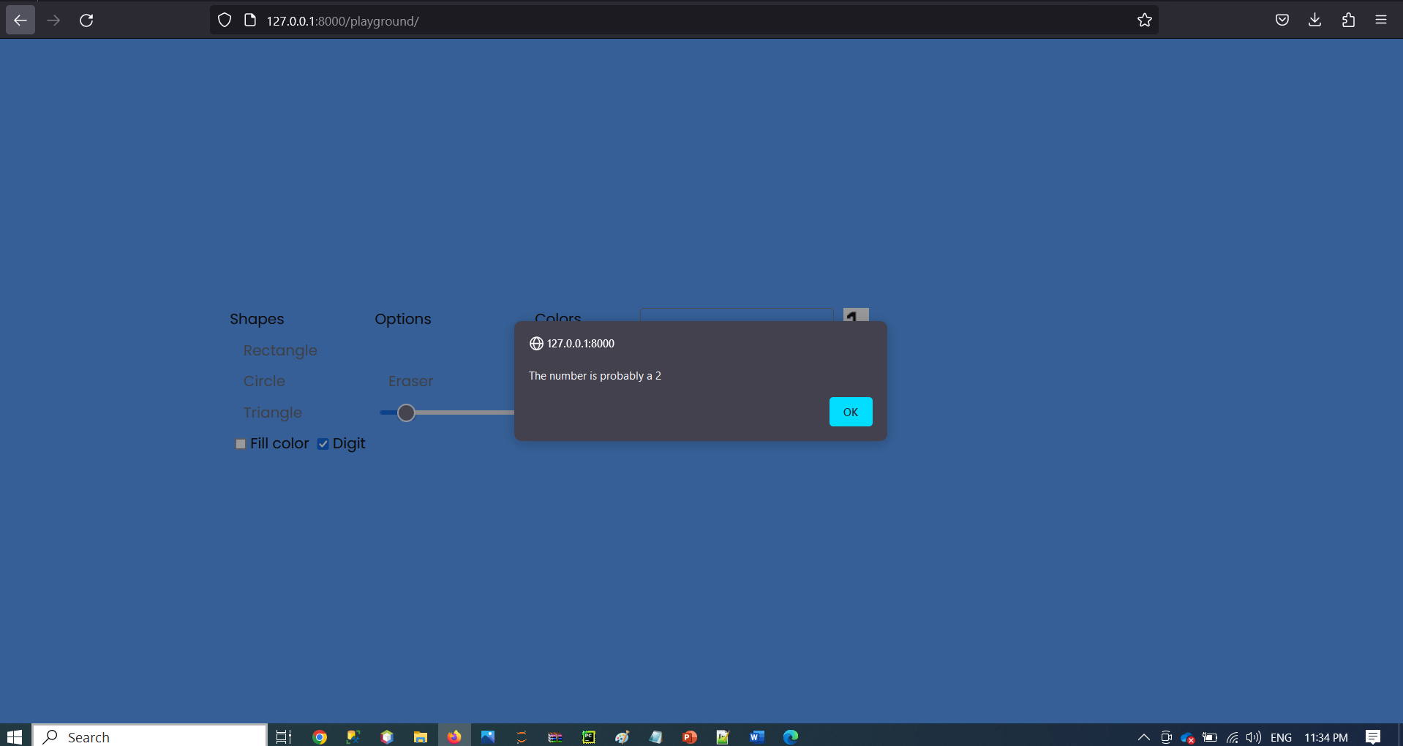
So when the user enters 2 add save the image he gets an alert message with the value predicted

Slide 5
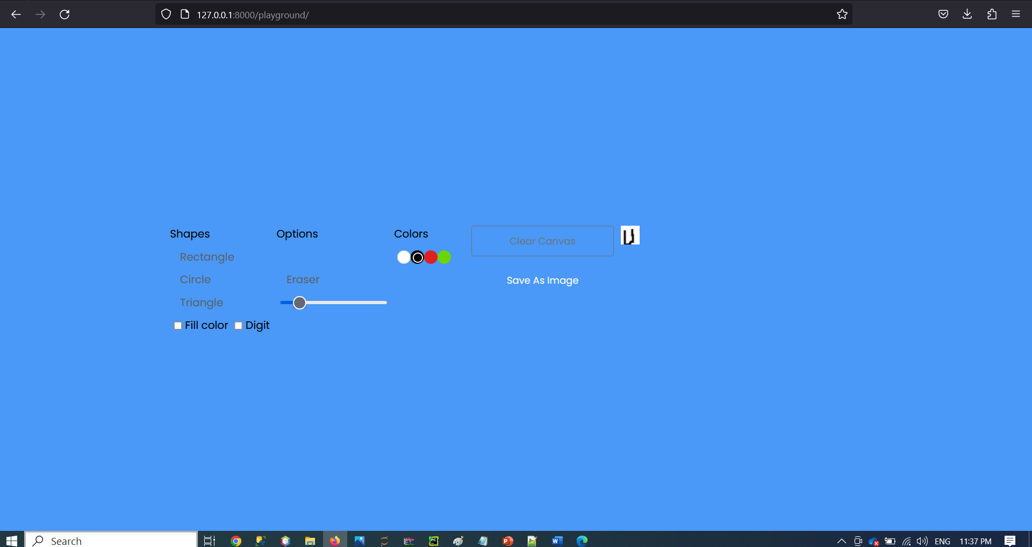
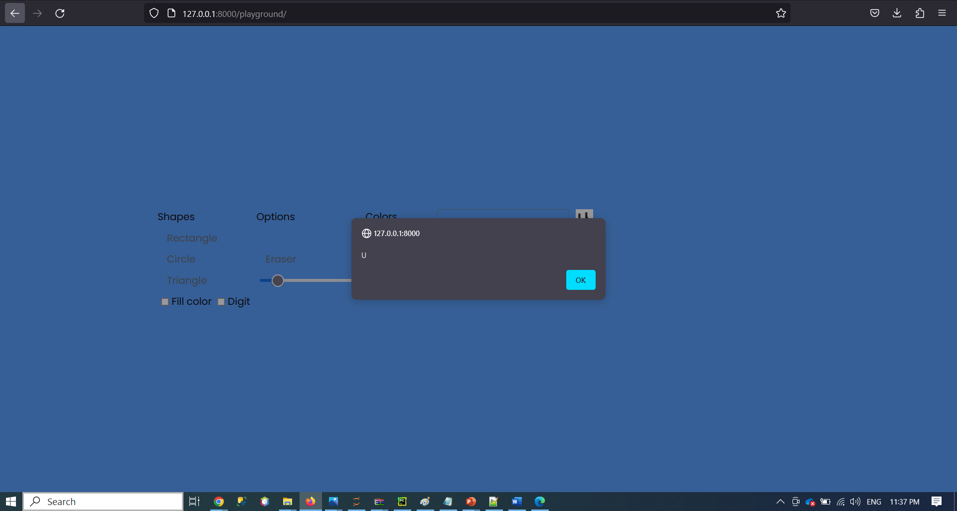
When the user enter U letter the server responds back with the predicted value.

